Slide 1


PROJECT
BANKRUPTCY PREVENTION

Slide 2

P 308 ( GROUP 3 )
TEAM MEMBERS
MENTOR
Mr. Sanjeev Kumar Sahoo
Mr. Anil K
Ms. Apoorva A Dugani
Ms. Sakshi Sanjay Nale
Mr. Valmiki Sankarsh Sanjay
Miss Siddhi Sovle
Mr. Karthik Muskula
DATE: 30.10.2023

Slide 3

BUSINESS PROBLEM :
Business companies goes bankrupt.
BUSINESS OBJECTIVE :
This is a classification project, since the variable to predict is binary (bankruptcy or non-bankruptcy).
The goal here is to model the probability that a business goes bankrupt from different features.

Slide 4
DETAILS OF DATASET :
The data file contains 7 features about 250 companies
The data set includes the following variables:
industrial_risk: 0=low risk, 0.5=medium risk, 1=high risk.
management_risk: 0=low risk, 0.5=medium risk, 1=high risk.
financial flexibility: 0=low flexibility, 0.5=medium flexibility, 1=high flexibility.
credibility: 0=low credibility, 0.5=medium credibility, 1=high credibility.
competitiveness: 0=low competitiveness, 0.5=medium competitiveness, 1=high competitiveness.
operating_risk: 0=low risk, 0.5=medium risk, 1=high risk.
class: bankruptcy, non-bankruptcy (target variable).

Slide 5
PROJECT ARCHITECTURE / PROJECT FLOW :
Business Understanding
Prediction
Deployment
Data Collection
Model Evaluation
Monitoring Data
Data Understanding
Train the Model
Data Preparation (Data Cleaning & EDA)
Model Building

Slide 6
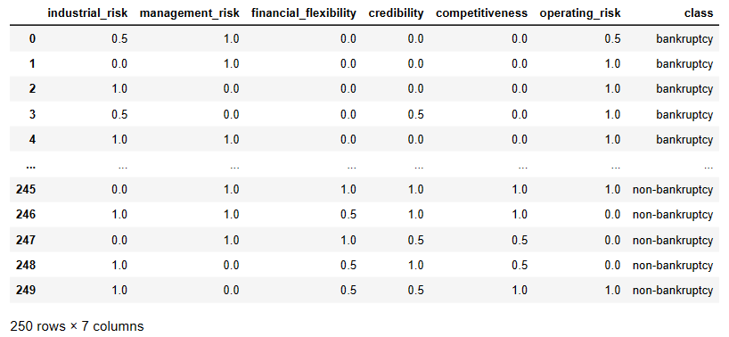
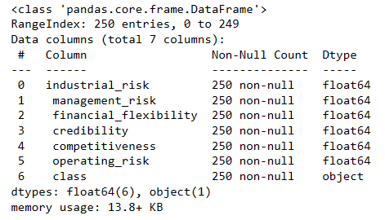
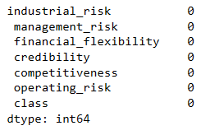
INFORMATION ABOUT DATASET :
Dataset :
Data Information :
Checking Missing values :
There is no missing values in dataset.
In the dataset we have 6 independent variables (X) which are features and one dependent/target variable (y) which is “class”.

Slide 7
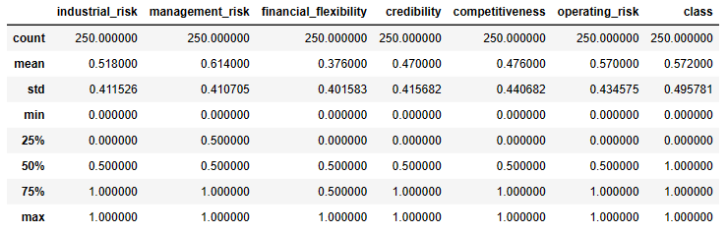
INFORMATION ABOUT DATASET :
Value count for all variables :
Data Describe :
industrial_risk :
1.0 89
0.5 81
0.0 80
Name: count, dtype: int64
management_risk :
1.0 119
0.5 69
0.0 62
Name: count, dtype: int64
financial_flexibility :
0.0 119
0.5 74
1.0 57
Name: count, dtype: int64
credibility :
0.0 94
1.0 79
0.5 77
Name: count, dtype: int64
competitiveness :
0.0 103
1.0 91
0.5 56
Name: count, dtype: int64
operating_risk :
1.0 114
0.0 79
0.5 57
Name: count, dtype: int64
class :
non-bankruptcy 143
bankruptcy 107
Name: count, dtype: int64

Slide 8
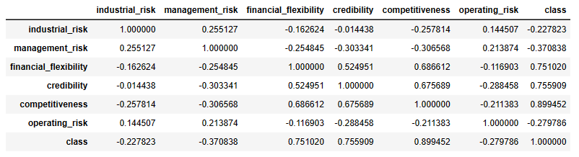
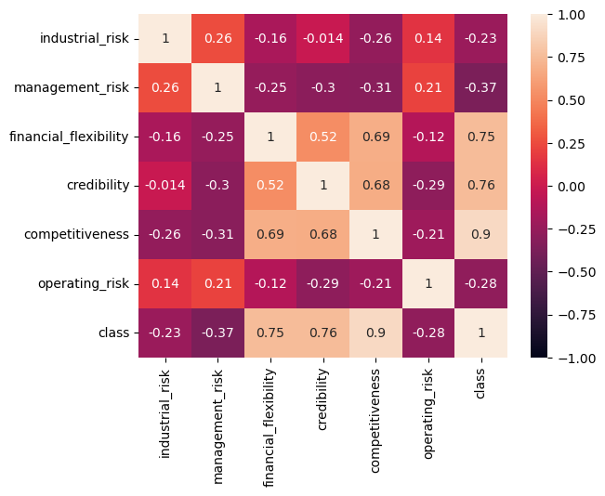
EXPLORATORY DATA ANALYSIS (EDA) :
Correlation Analysis :
Here we can see “Competitiveness” is the variable having highest correlation with target variable “class” followed by “Credibility” and “Financial Flexibility”.
Also there is a strong positive correlation between “Competitiveness & Financial Flexibility”, “Competitiveness & Credibility”.

Slide 9
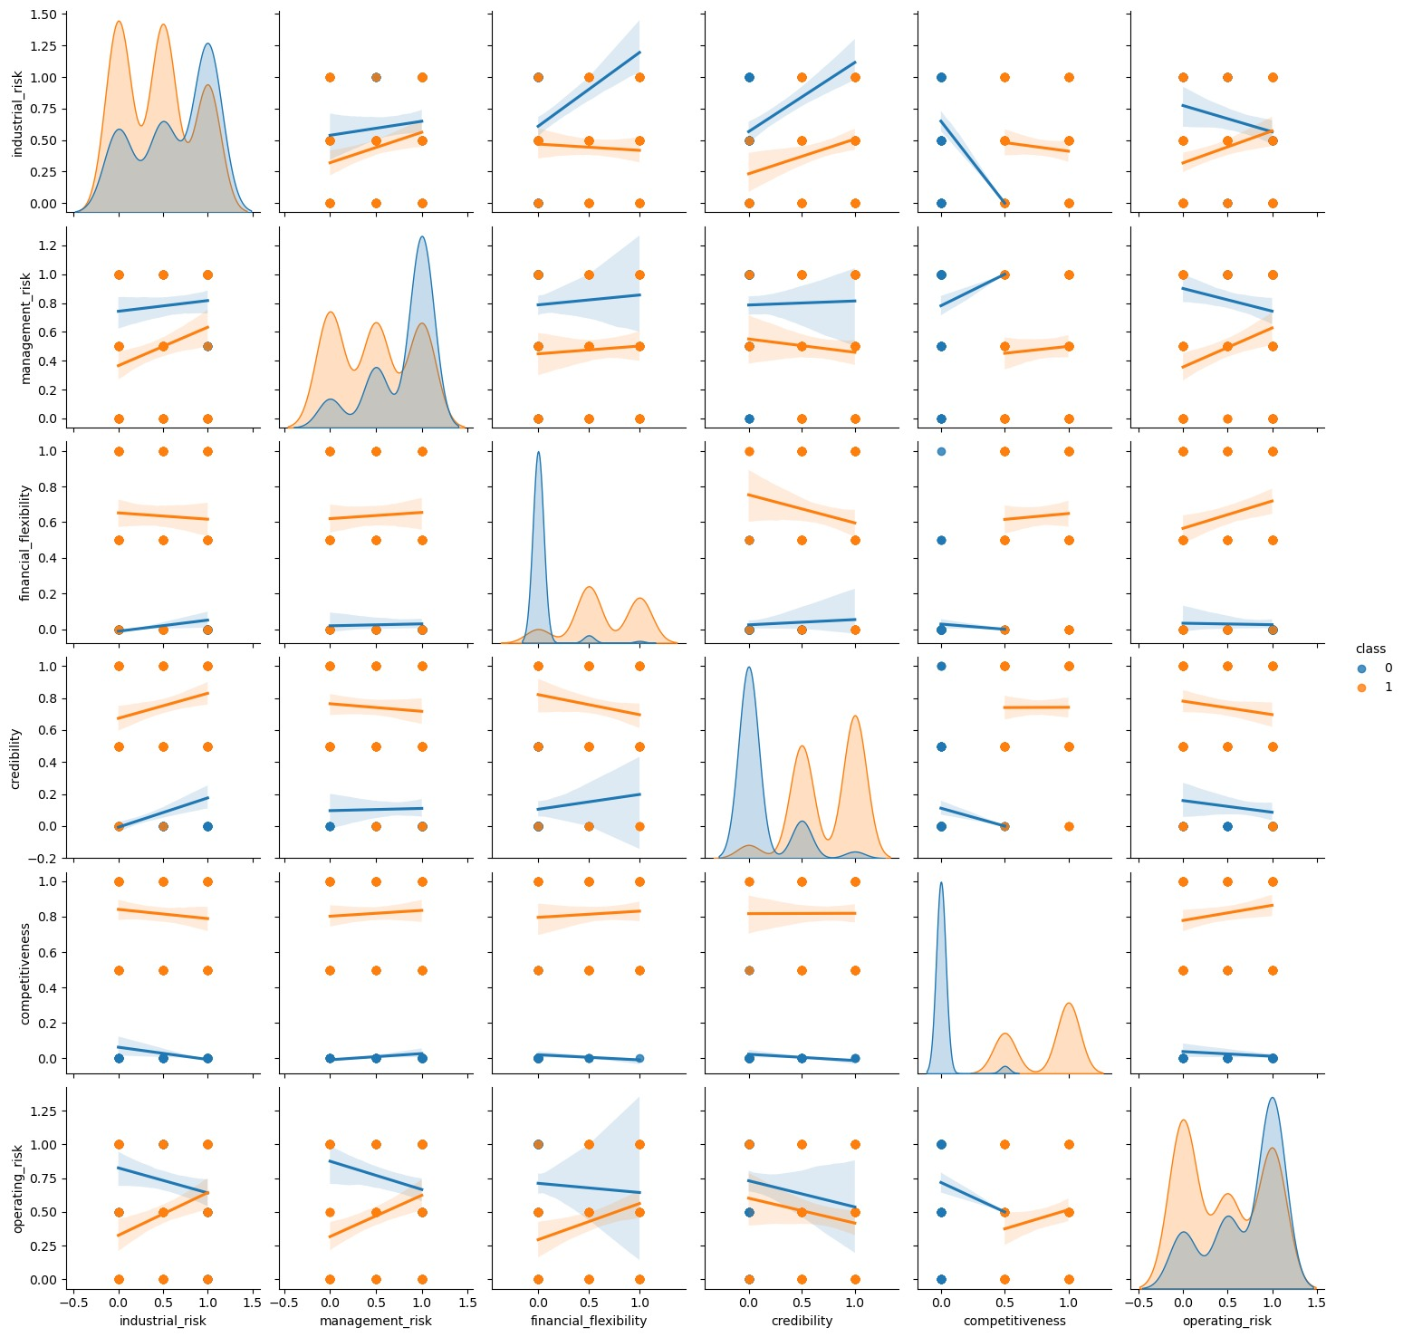
EXPLORATORY DATA ANALYSIS (EDA) :
Visualizing Correlation using Pair plot :
When less industrial risk is there, there is low chances of bankruptcy.
When management risk is high then the chance of bankruptcy is also high.
The bank which has less financial flexibility, the chances of bankruptcy is very high.
Also for low credibility the chances of bankruptcy is very high.
If the risk of competitiveness is very high then there is no chance of bankruptcy or we can say no competitiveness means yes to bankruptcy.
High operating risk means high chance of bankruptcy.

Slide 10
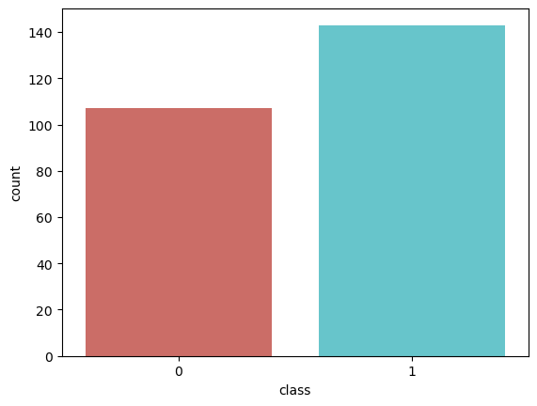
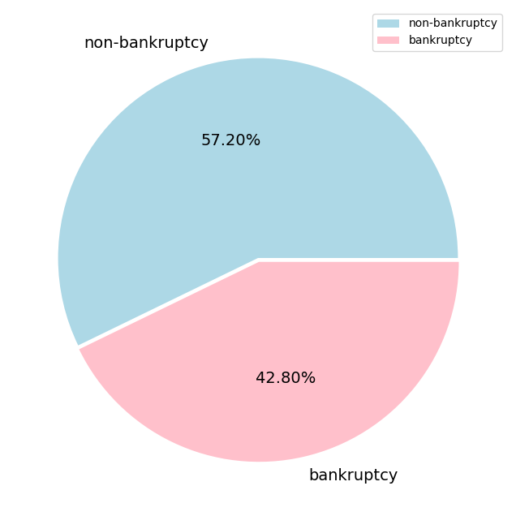
EXPLORATORY DATA ANALYSIS (EDA) :
Visualizing Count plot & Pie chart for target variable ‘class’ :
Class Column has Bankruptcy 107 unique items and Non-bankruptcy 143 unique items.

Slide 11
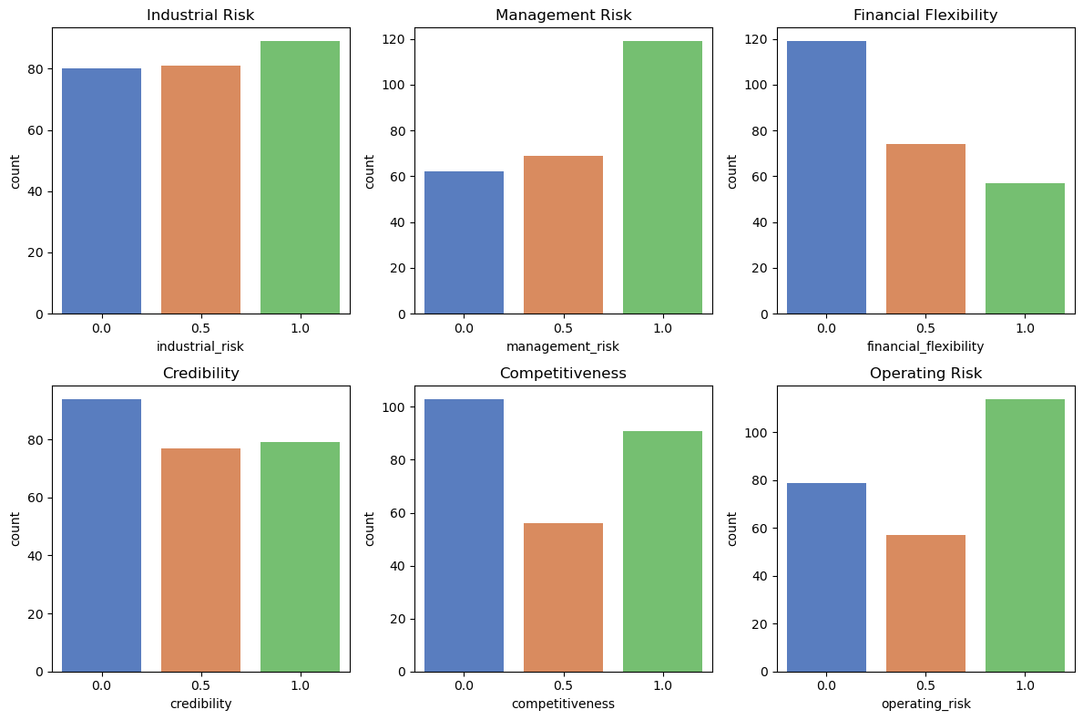
EXPLORATORY DATA ANALYSIS (EDA) :
Visualizing Count plot for all Independent features :

Slide 12
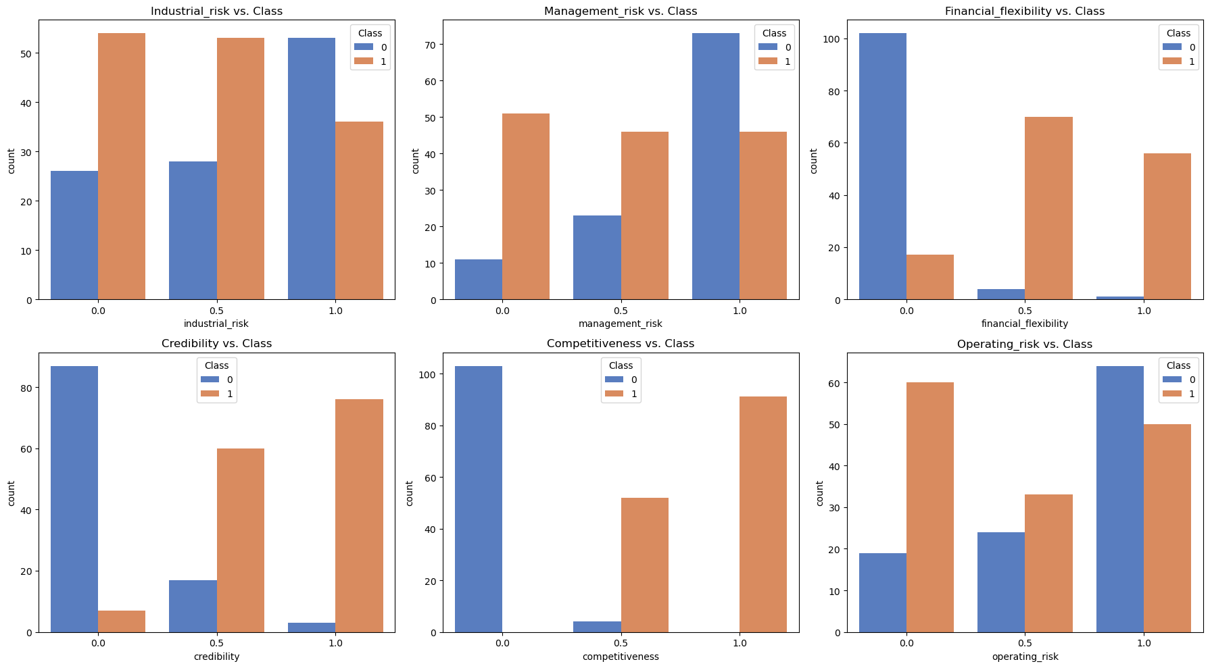
EXPLORATORY DATA ANALYSIS (EDA) :
Comparing all Independent features with target variable ‘class’ :

Slide 13
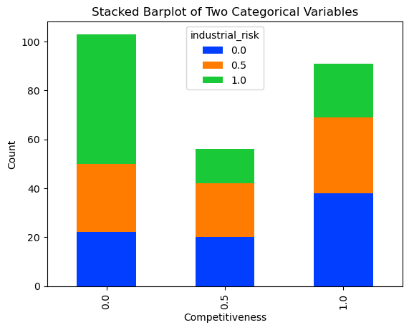
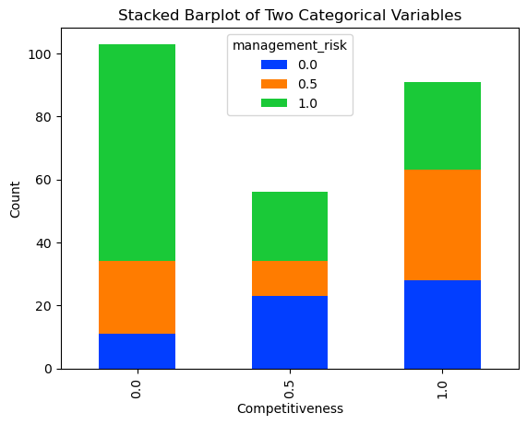
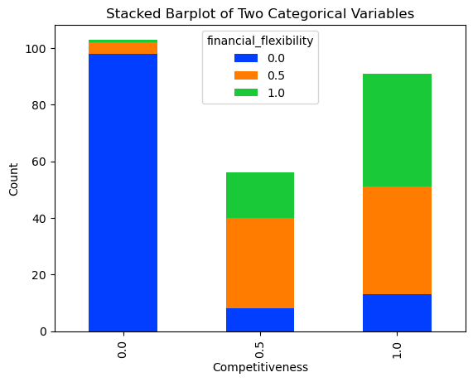
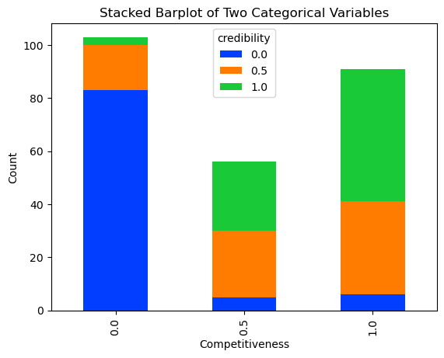
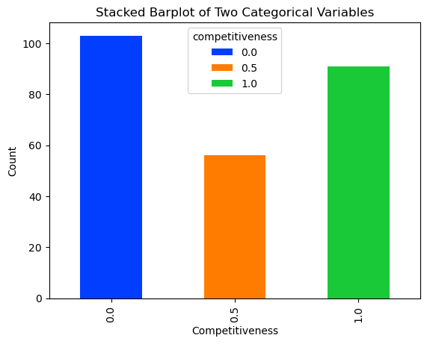
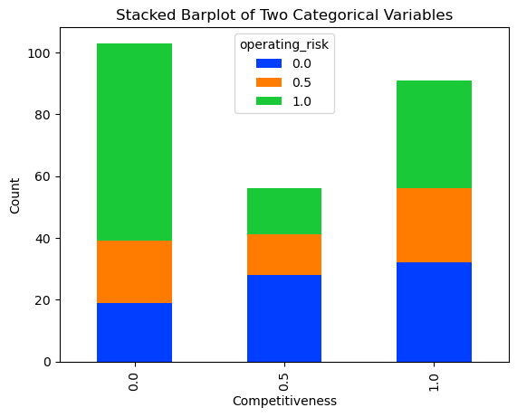
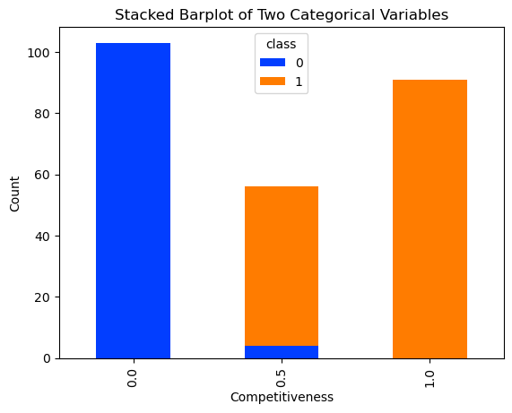
EXPLORATORY DATA ANALYSIS (EDA) :
Comparing all other variables with ‘Competitiveness’ :
More operating risk less competitiveness
No competitiveness, yes to bankruptcy

Slide 14
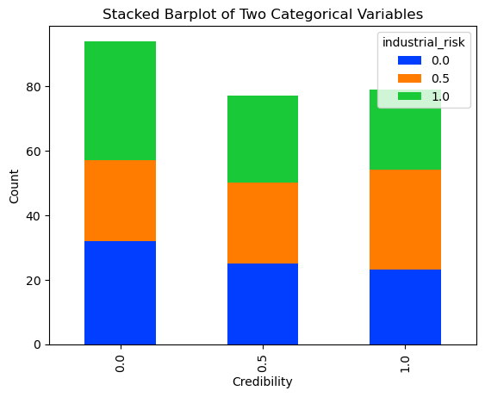
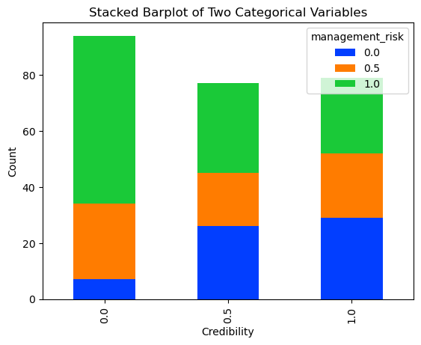
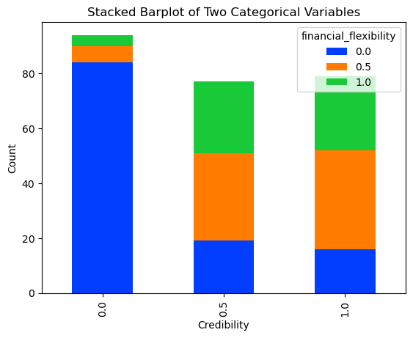
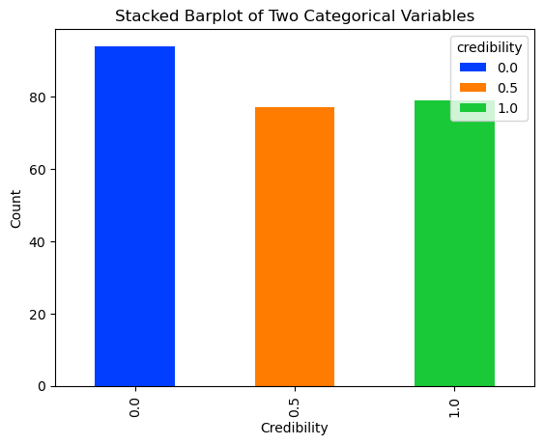
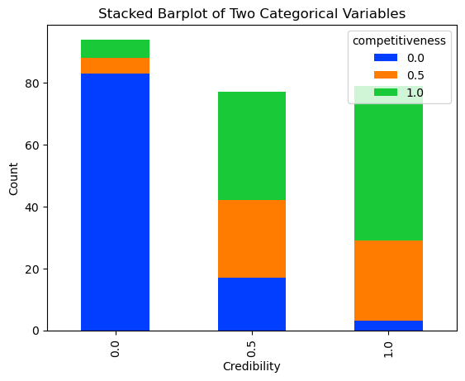
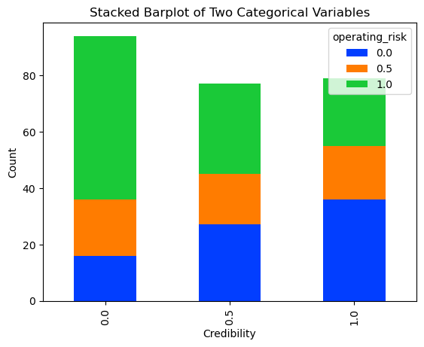
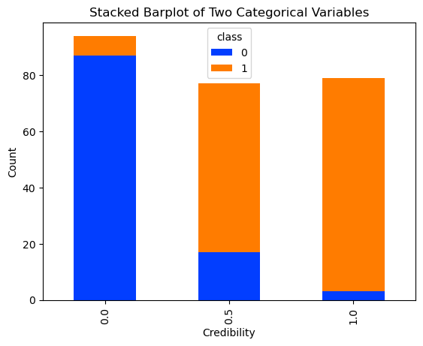
EXPLORATORY DATA ANALYSIS (EDA) :
Comparing all other variables with ‘Credibility’ :
Low credibility indicates high industrial risk
Low credibility indicates very low financial flexibility
Low credibility means very low competitiveness
Ultimately low credibility means high chances of bankruptcy.

Slide 15
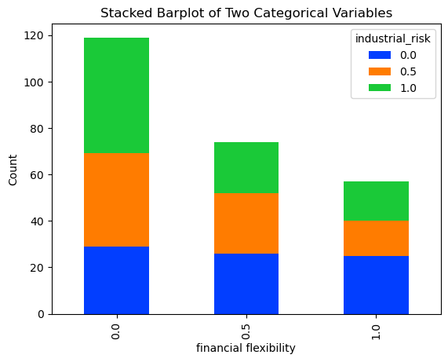
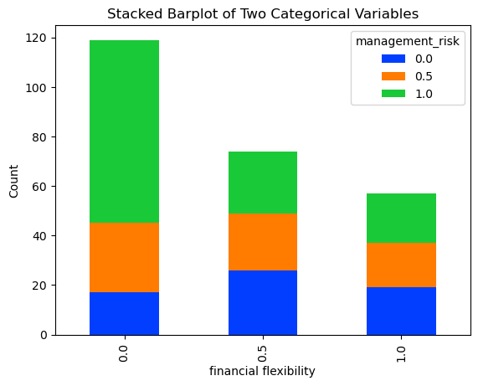
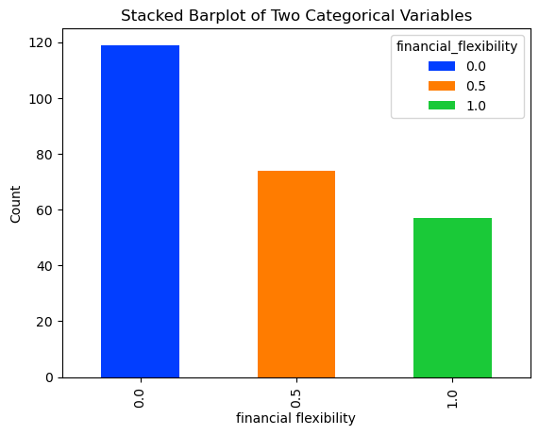
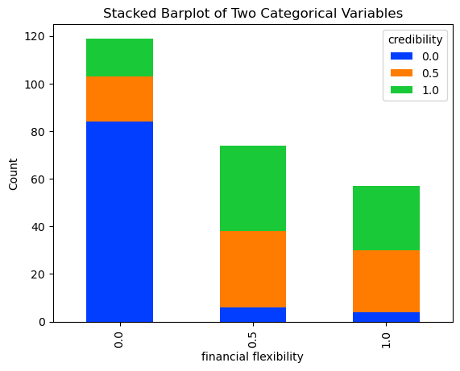
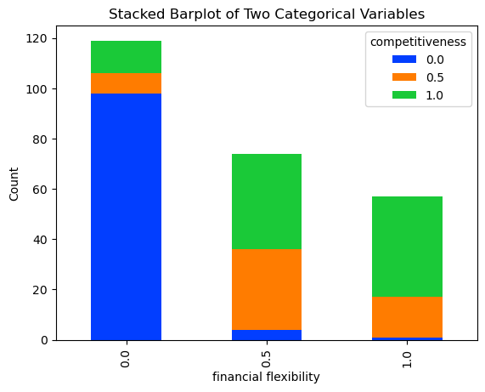
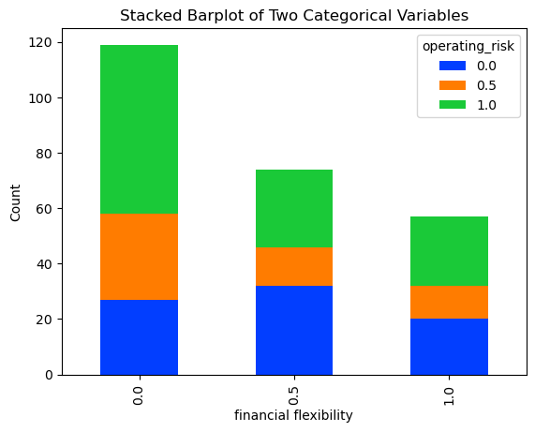
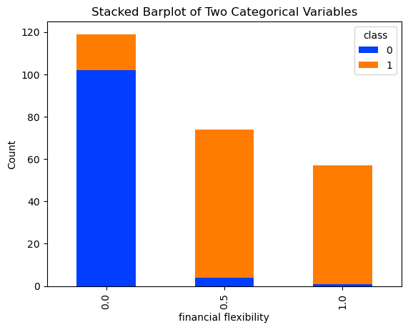
EXPLORATORY DATA ANALYSIS (EDA) :
Comparing all other variables with ‘Financial flexibility’ :
When industrial risk is there, financial flexibility is not there.
When management risk is there financial flexibility is not there.
When credibility is not there, financial flexibility is also not there.
Competitiveness of all the banks depends highly on the financial flexibility.
High operating risk can lead to risk in financial flexibility.
Ultimately, the bank which has more financial flexibility, has got very less chances of bankruptcy.

Slide 16
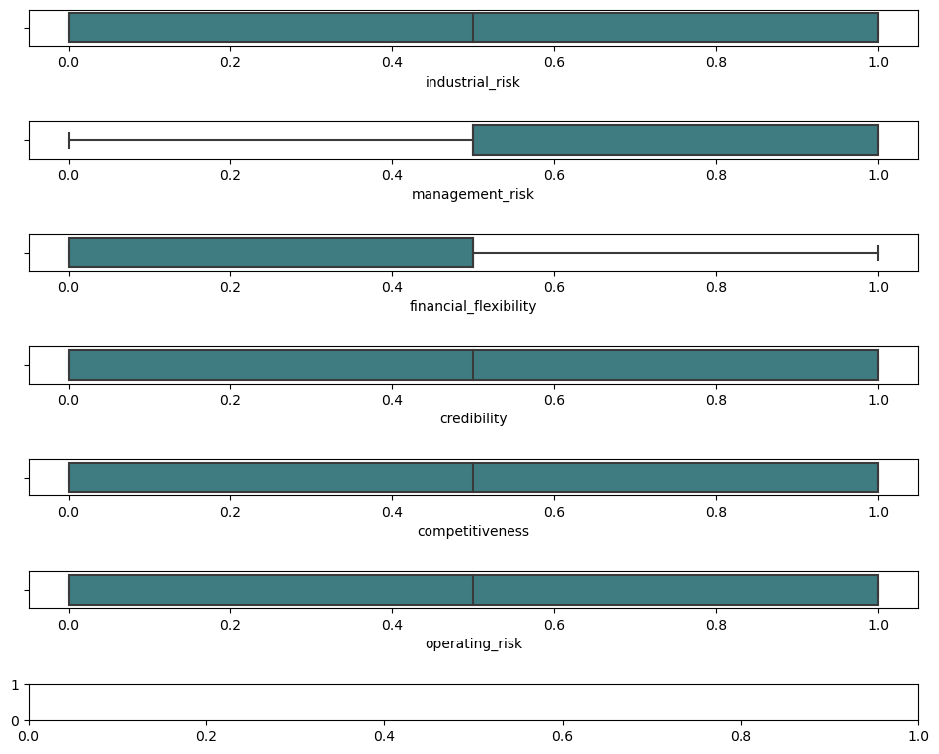
EXPLORATORY DATA ANALYSIS (EDA) :
Outlier Detection :
We can see that no outliers are present.

Slide 17
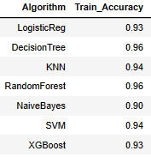
MODEL BUILDING :
Here we have used 7 Machine Learning Algorithms to build the models
Logistic Regression
Decision Tree
KNN ( K-Nearest Neighbors )
Random Forest
Naive Bayes
SVM ( Support Vector Machine )
XgBoost
After model building we trained the model and got training accuracy score as shown in figure
As per results all the Algorithms are giving good score, but Decision Tree and Random Forest are two with highest score.

Slide 18
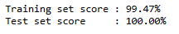
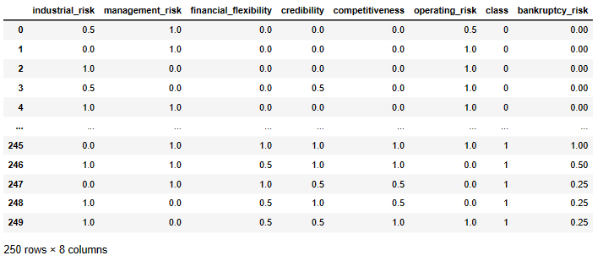
MODEL EVALUATION :
After doing the model evaluation, from the accuracy score it’s found that the model is over fitted.
To avoid over fitting problem we used Feature Engineering method.
Introducing new feature ‘bankruptcy_risk’ which all together takes the value of ‘competitiveness’, ‘credibility’, ‘financial_flexibility’.

Slide 19
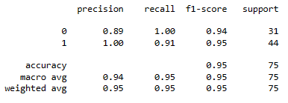
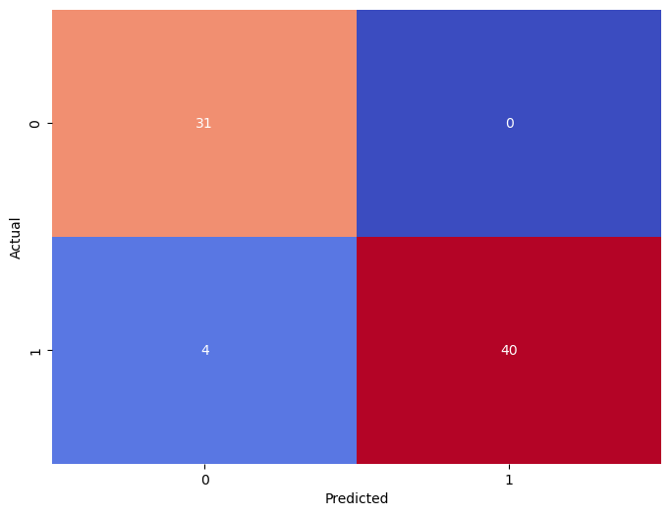
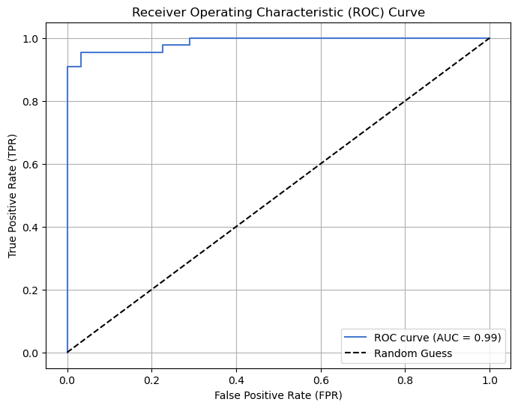
MODEL EVALUATION :
1. Logistic Regression
Classification Report
Confusion Matrix
ROC Curve
From classification report we got
Accuracy Score: 0.9466
Precision Score: 1.00
Recall Score: 0.9090
F1 Score: 0.9523
Here in confusion matrix out of those 75 cases, the classifier predicted ‘non-bankruptcy’ 40 times and ‘bankruptcy’ 35 times.
In actual it’s 44 times ‘non-bankruptcy’ and 31 times ‘bankruptcy’.
Here AUC-ROC Score is 0.9545 , which is a good score.
So here overall model performance is good as per score.

Slide 20
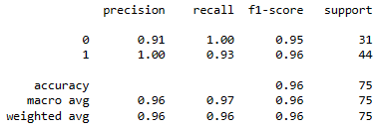
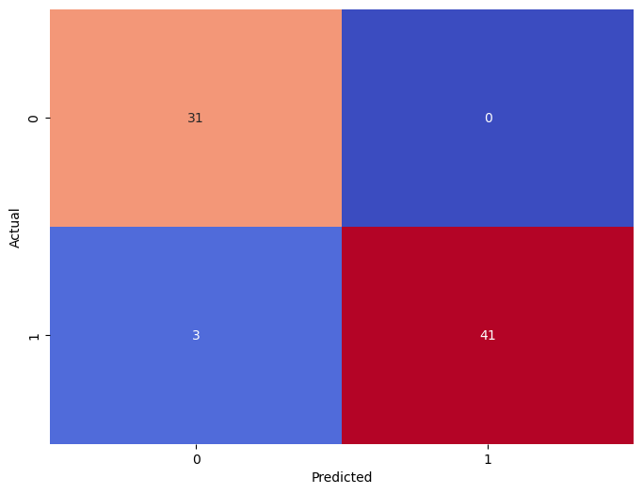
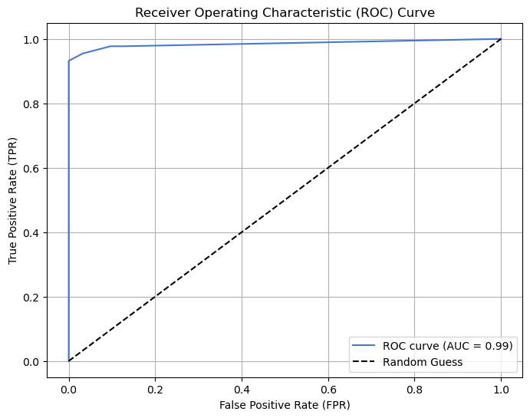
MODEL EVALUATION :
2. Decision Tree
Classification Report
Confusion Matrix
ROC Curve
From classification report we got
Accuracy Score: 0.96
Precision Score: 1.00
Recall Score: 0.9318
F1 Score: 0.9647
Here in confusion matrix out of those 75 cases, the classifier predicted ‘non-bankruptcy’ 41 times and ‘bankruptcy’ 34 times.
In actual it’s 44 times ‘non-bankruptcy’ and 31 times ‘bankruptcy’.
Here AUC-ROC Score is 0.9659 , which is a good score.
So here overall model performance is good as per score.

Slide 21
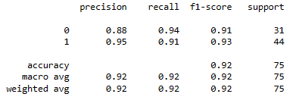
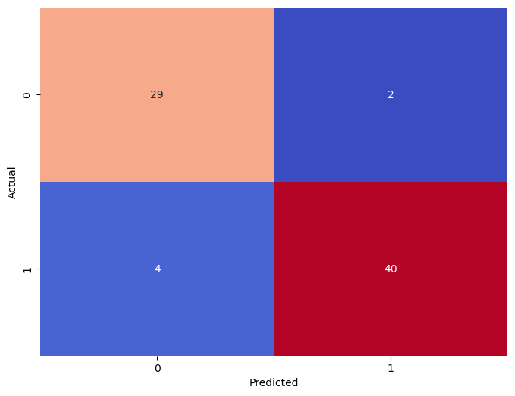
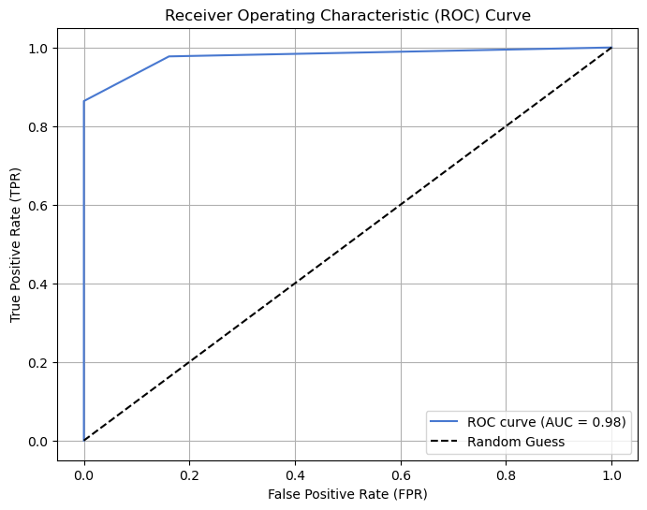
MODEL EVALUATION :
3. KNN ( K-Nearest Neighbors )
Classification Report
Confusion Matrix
ROC Curve
From classification report we got
Accuracy Score: 0.92
Precision Score: 0.9523
Recall Score: 0.9090
F1 Score: 0.9302
Here in confusion matrix out of those 75 cases, the classifier predicted ‘non-bankruptcy’ 42 times and ‘bankruptcy’ 33 times.
In actual it’s 44 times ‘non-bankruptcy’ and 31 times ‘bankruptcy’.
Here AUC-ROC Score is 0.9222 , which is a good score.
So here overall model performance is good as per score.

Slide 22
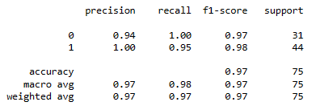
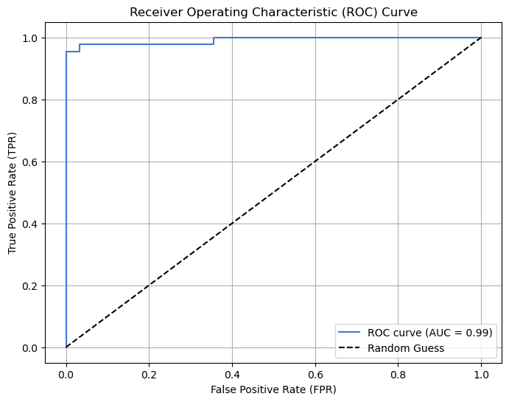
MODEL EVALUATION :
4. Random Forest
Classification Report
Confusion Matrix
ROC Curve
From classification report we got
Accuracy Score: 0.9733
Precision Score: 1.00
Recall Score: 0.9545
F1 Score: 0.9767
Here in confusion matrix out of those 75 cases, the classifier predicted ‘non-bankruptcy’ 41 times and ‘bankruptcy’ 34 times.
In actual it’s 44 times ‘non-bankruptcy’ and 31 times ‘bankruptcy’.
Here AUC-ROC Score is 0.9772 , which is a good score.
So here overall model performance is good as per score.

Slide 23
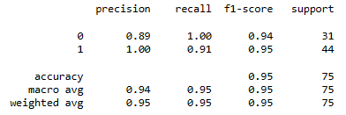
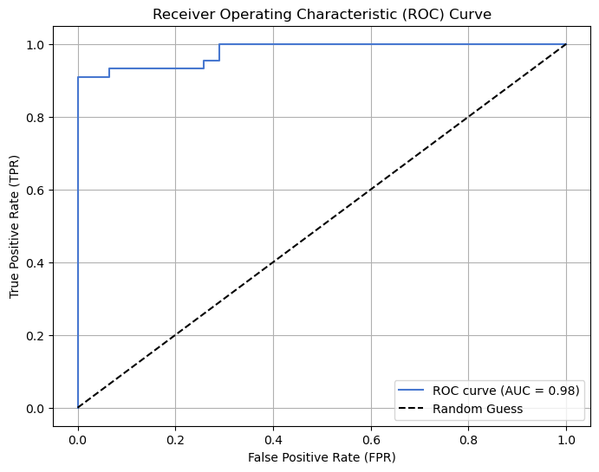
MODEL EVALUATION :
5. Naive Bayes
Classification Report
Confusion Matrix
ROC Curve
From classification report we got
Accuracy Score: 0.9466
Precision Score: 1.00
Recall Score: 0.9090
F1 Score: 0.9523
Here in confusion matrix out of those 75 cases, the classifier predicted ‘non-bankruptcy’ 40 times and ‘bankruptcy’ 35 times.
In actual it’s 44 times ‘non-bankruptcy’ and 31 times ‘bankruptcy’.
Here AUC-ROC Score is 0.9545 , which is a good score.
So here overall model performance is good as per score.

Slide 24
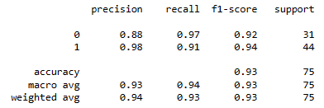

MODEL EVALUATION :
6. SVM ( Support Vector Machine )
Classification Report
Confusion Matrix
ROC Curve
Here AUC-ROC Score is 0.9384 , which is a good score.
From classification report we got
Accuracy Score: 0.9333
Precision Score: 0.9756
Recall Score: 0.9090
F1 Score: 0.9411
Here in confusion matrix out of those 75 cases, the classifier predicted ‘non-bankruptcy’ 41 times and ‘bankruptcy’ 34 times.
In actual it’s 44 times ‘non-bankruptcy’ and 31 times ‘bankruptcy’.
So here overall model performance is good as per score.

Slide 25



MODEL EVALUATION :
7. XgBoost
Classification Report
Confusion Matrix
ROC Curve
From classification report we got
Accuracy Score: 0.9466
Precision Score: 0.9545
Recall Score: 0.9545
F1 Score: 0.9545
Here in confusion matrix out of those 75 cases, the classifier predicted ‘non-bankruptcy’ 44 times and ‘bankruptcy’ 31 times.
In actual it’s 44 times ‘non-bankruptcy’ and 31 times ‘bankruptcy’.
Here AUC-ROC Score is 0.9450 , which is a good score.
So here overall model performance is good as per score.

Slide 26


MODEL PERFORMANCE :
So according to the results performance of all the models are good, but Decision tree and Random forest are the best performers.

Slide 27

MODEL DEPLOYMENT :
We used Streamlit to deploy the model.
Here we used Decision tree model for Deployment.
As the Test Accuracy of this model is 96%, we can say our 96% predictions will be correct.

Slide 28
CONCLUSION :
Challenges Faced :
At first the dataset was not separated while reading it.
Then our target variable “class” containing Categorical variables, which is not possible to get correlation.
Also we can say the dataset is slightly imbalanced as it contains 42.80% observation of Bankruptcy and 57.20% of Non- Bankruptcy.
At the time of checking correlation we observed that 3 features having highest correlation with target variable.
The major problem we have faced is Overfitting issue at the time of model Evaluation.
Choosing the best model for deployment.
Platform selection for deployment.

Slide 29
How did we overcome the challenges :
We did separate the dataset by column wise at the time of reading.
So first we did convert the “class” column categorical into binary form.
Slightly imbalanced is not a major issue as it’s acceptable for machine learning algorithms, so we go through it.
We observed that 3 features having highest correlation with target variable, so it’s not a major issue but we can say on these factors bank should give focus more to avoid bankruptcy.
To avoid overfitting issue we used Feature Engineering technique, While solving the overfitting issue, we had to engineer new features which was challenging.
Feature Selection : While proceeding with the model building part, with the idea of feature engineering we created a new feature. In order to get better accuracy, we removed 2 features, since the new feature included the interaction of these 2 features.
Finally after model building Decision tree model giving the best performance, So we used this model for deployment.
We used Streamlit platform for deployment as it’s easy to use and also free to hosting.

Slide 30
Thank
You !

